Slide 1
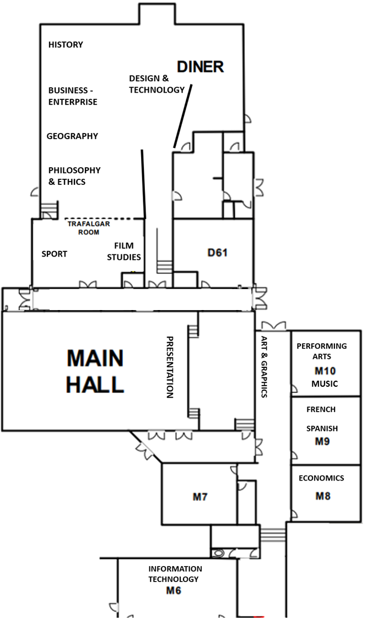

Slide 2

KEY STAGE 4
OPTIONS

Slide 3


Slide 4


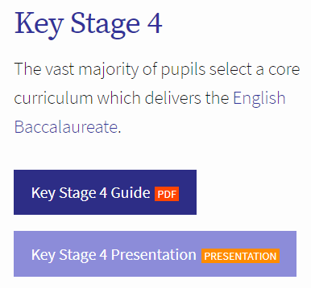

Slide 5



Slide 6
Key Stage 4
English
Maths
Science
Sport
Religious Studies
Citizenship,PSHE,CEIAG
Mandatory
KS4
Arts
Technology
Humanities
Modern Foreign Languages
Entitlement

Slide 7
Key Stage 4 at The Harvey
Personalised
Subject Range
Quality Outcomes

Slide 8

Maths
English
Science
HGS
KS4
Curriculum
Religious Education
Physical Education
French or Spanish
Geography or History
Option
Option

Slide 9
It provides a strong academic curriculum which is an excellent foundation for Higher Education, including courses at the premier universities.
Maths
English
Science
HGS
KS4
Curriculum
Religious Education
Physical Education
Universities and employers increasingly expect pupils to have this portfolio of qualifications.
French or Spanish
Geography or History
Option
Option

Slide 11
The English Baccalaureate
English Language & Literature
Mathematics
Sciences
Humanity
(Geography or History)
Modern Foreign Language
(French or Spanish)

Slide 12
9
GCSE Grades
8
7
6
Typical grade requirement for an A Level
5
Grade 5 or above is a ‘strong pass’
4
Grade 4 is a ‘standard pass’
3

Slide 13
Maths
English
Science
Science
HGS
KS4
Curriculum
Religious Education
Physical Education
Combined Science (Trilogy)
Separate Sciences:
Biology
Chemistry
Physics
French or Spanish
Geography or History
Option
Option

Slide 14
The Options
Art & Design
Business Enterprise
Design Technology
Economics
Film Studies
French
Geography
History
Information Technology
Music
Performing Arts
Philosophy & Ethics
Spanish
Sport

Slide 15
How to choose?
Broad & Balanced
Aptitude
Enjoyment

Slide 16
How to choose?
Subject Demands
Subject Summaries
Future Learning

Slide 17

How to choose?
Capacity
Reserve Choice

Slide 18

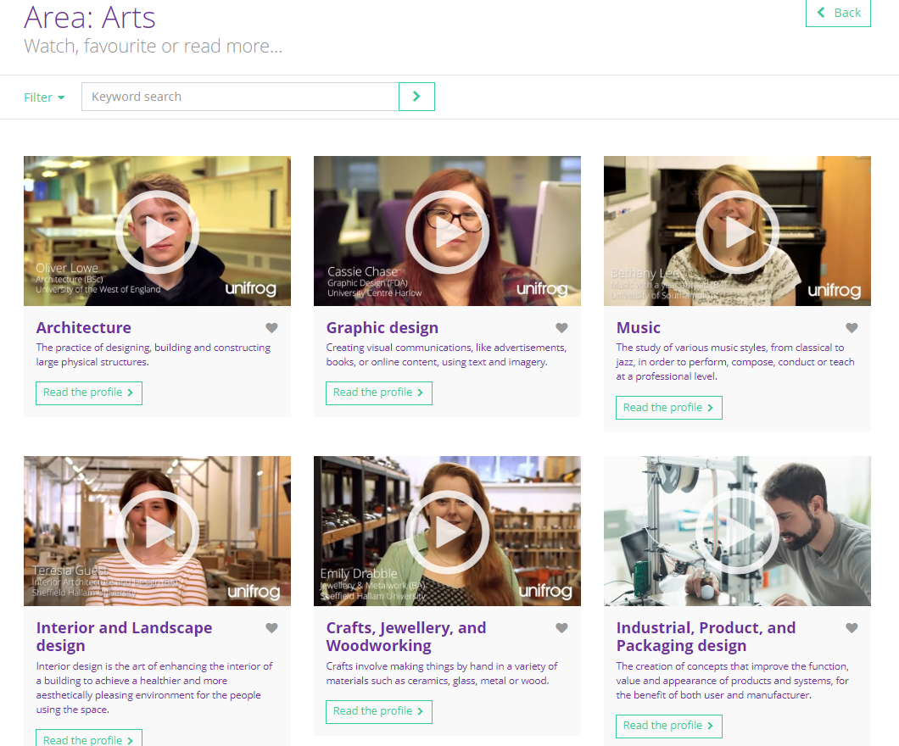

Slide 19
The Options
Art & Design
Business Enterprise
Design Technology
Economics
Film Studies
French
Geography
History
Information Technology
Music
Performing Arts
Philosophy & Ethics
Spanish
Sport

Slide 20
Timetable
Progress Reports
Wed 5th Feb
Parents’ Evening
Wed 12th Feb
Enterprise Day & Information Evening
Tues 25th Feb
Option Forms Completed:
Wed 26th Feb – Fri 21st Mar
Option Groups Formulated
May 2025

Slide 21


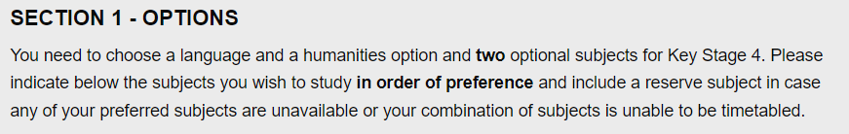

Slide 22
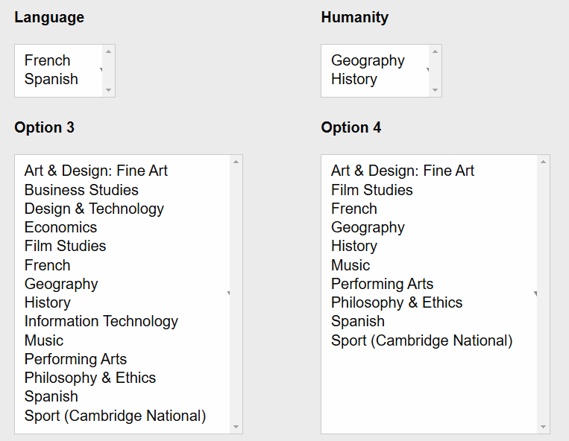

Slide 23
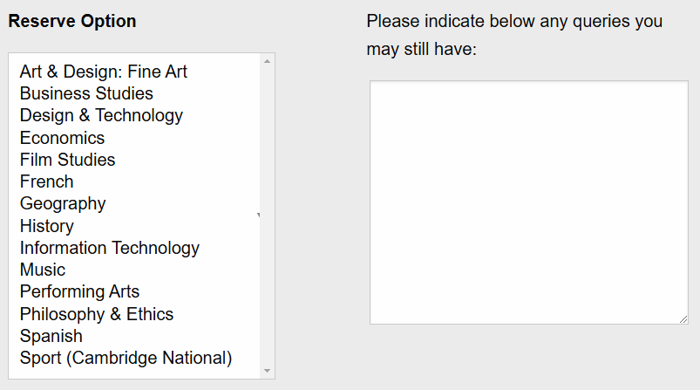


Slide 24
The Options
Art & Design
Business Enterprise
Design Technology
Economics
Film Studies
French
Geography
History
Information Technology
Music
Performing Arts
Philosophy & Ethics
Spanish
Sport

